Slide 2



Tight Pickle Productions

Slide 3
Play test results
Feedback
Negative / positive
Improvements

Slide 4

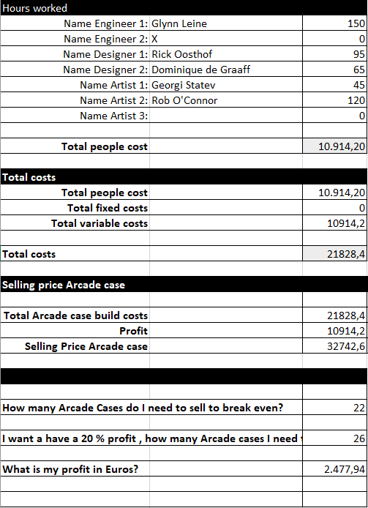
Cost Calculations
Hours put in
Costs
Arcade casing
Profits

Slide 5
Trello
https://trello.com/b/hwzg7ors/project-lift-off

Slide 6
Glynn Leine (engineer)
Everything that has to do with coding
Arduino

Slide 7
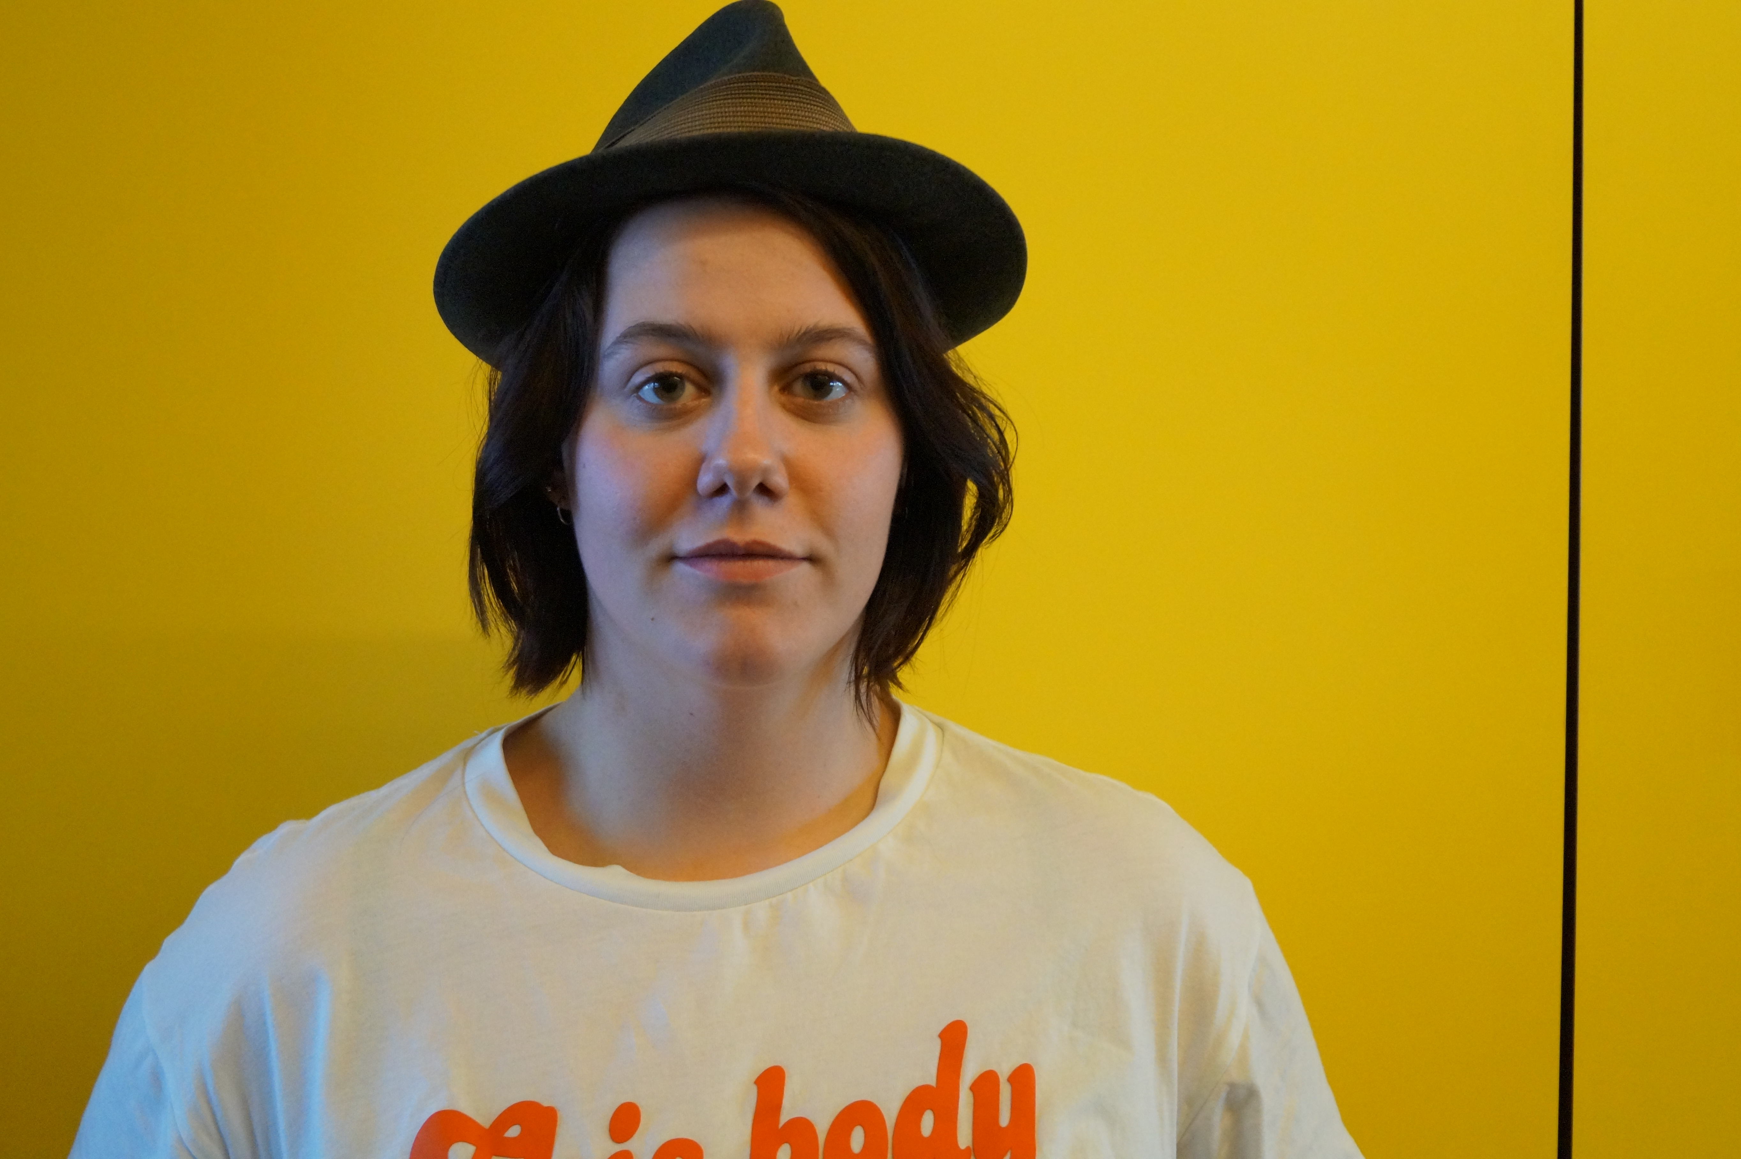
Dominique de Graaff (designer)
PowerPoint presentations
Website
Game and trailer synopsis
Create the design for the speaker and light output
Laser cut the board (CaseDesign)
Playtest
GameDesign

Slide 8

Rick Oosthof
Create the controller
Level Design
Electrical Enginenering

Slide 9
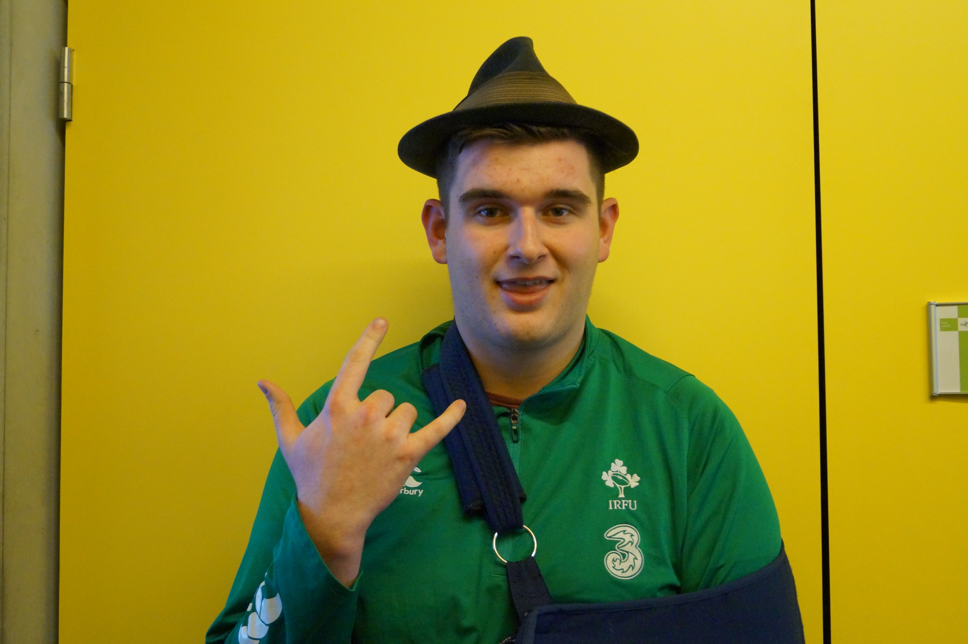
Rob O’Connor
Art
Filming and editing the trailer
Scrum Master
Animation
Pictures

Slide 10
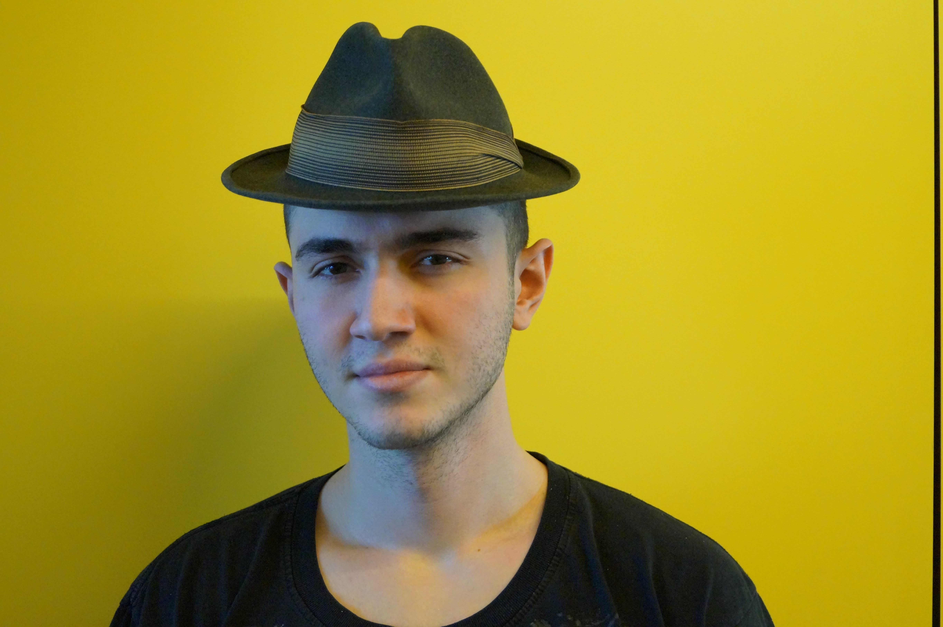
Georgi Statev
Art stuff
Tileset
Animation
Poster
Concept Art

Slide 11
Teamwork
Reflection
Communication could be better
Be at school on time
Peer assessment
Roles (examples)

Slide 12
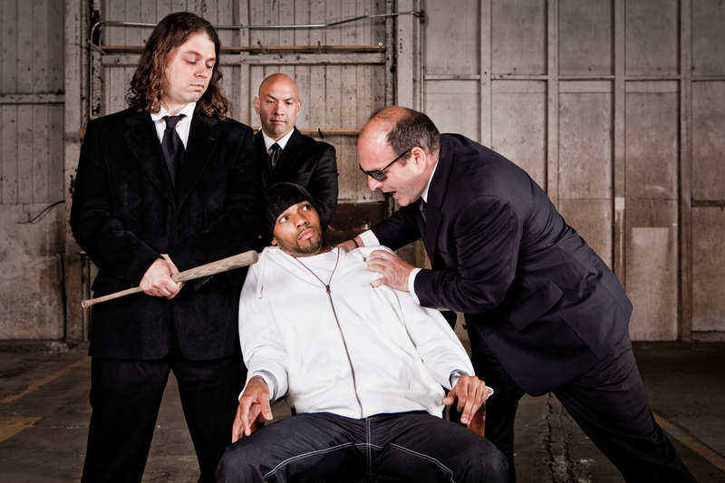
Questions?

